Slide 1







HELLO WORLD
Notes:
Hello world, I am Christian v. barte and tonight I am going to present my app

Slide 2







PANDEMIC

Slide 3

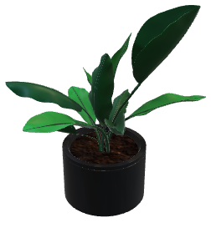
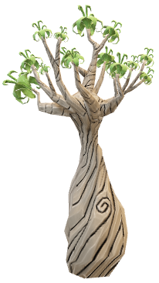
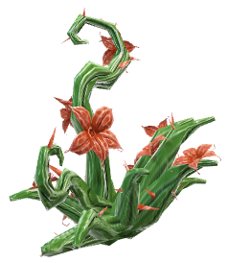
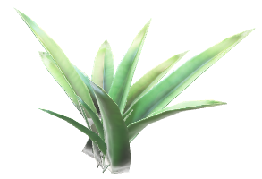


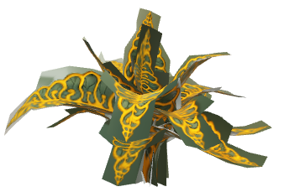

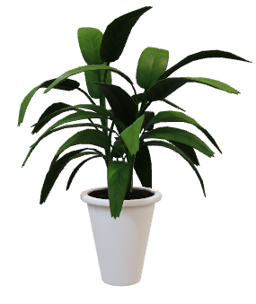
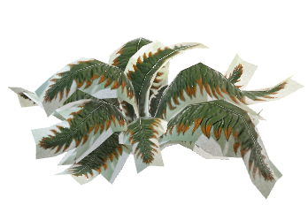
P
L
A
N
T
PANDEMIC
The lockdown has sparked a widespread interest in gardening among Filipinos, becoming popular in both rural and urban areas.This newfound passion for gardening is reflected in the terms "plantito" for males and "plantita" for females, which refer to individuals who take pleasure in cultivating and nurturing plants, as noted by Sunga (2021).
Notes:
It all started with the pandemic, as lockdown measures were imposed worldwide. During this time, people found themselves with more free time and a desire to explore new hobbies.

Slide 4
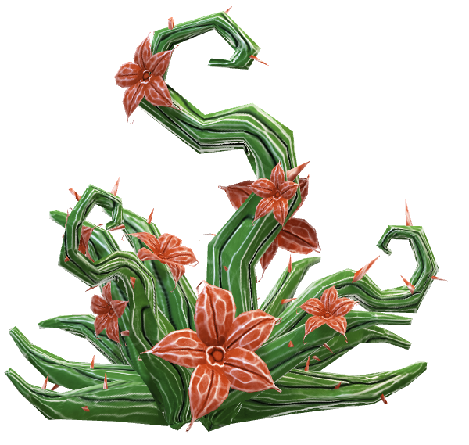
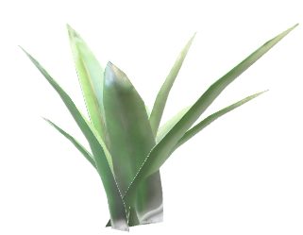

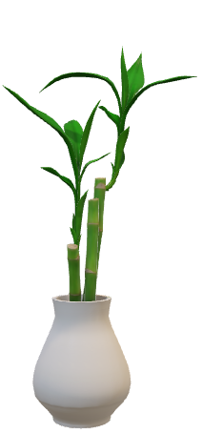
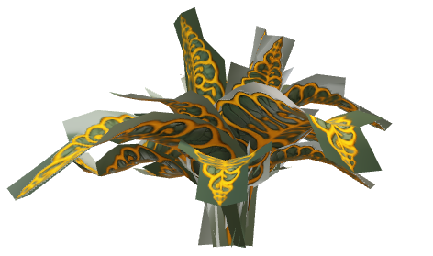
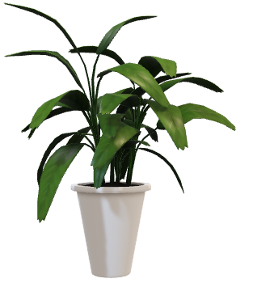

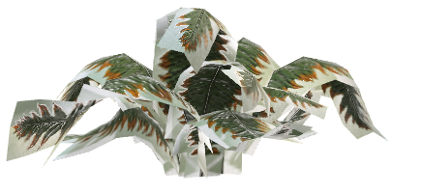

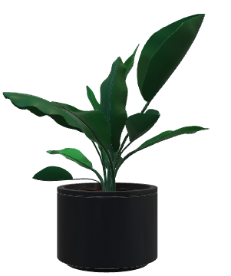
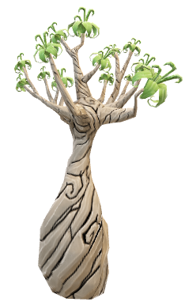
P
L
A
N
T
The lockdown has sparked a widespread interest in gardening among Filipinos, becoming popular in both rural and urban areas.This newfound passion for gardening is reflected in the terms "plantito" for males and "plantita" for females, which refer to individuals who take pleasure in cultivating and nurturing plants, as noted by Sunga (2021).
PANDEMIC
Notes:
One such hobby that gained significant popularity, especially among our parents, is taking care of plants. They have affectionately been referred to as 'plantitos' for males and 'plantitas' for females.
Before the pandemic, my mother had always been passionate about growing and nurturing plants. She found joy in attending to her garden and watching her plants flourish. Little did my mother know that the arrival of the pandemic would lead to a significant boom in the plant industry.

Slide 5


BUS
I
N
E
S
S
The lockdown has sparked a widespread interest in gardening among Filipinos, becoming popular in both rural and urban areas.This newfound passion for gardening is reflected in the terms "plantito" for males and "plantita" for females, which refer to individuals who take pleasure in cultivating and nurturing plants, as noted by Sunga (2021).
Notes:
It was during this time that my mother saw an opportunity to turn her passion into a business. With her green thumb and knowledge of plants, she started cultivating a wide variety of plant species and offering them for sale.

Slide 6




BUS
I
N
E
S
S
Notes:
However, as my mother's plant business grew, so did the challenges of managing it effectively. She relied on manual methods to keep track of her inventory, prices, and profits. This involved writing down plant names, prices, and other details on paper, which was time-consuming and prone to errors.

Slide 7



P
R
O
B
L
E
M
Notes:
However, as my mother's plant business grew, so did the challenges of managing it effectively. She relied on manual methods to keep track of her inventory, prices, and profits. This involved writing down plant names, prices, and other details on paper, which was time-consuming and prone to errors.

Slide 8
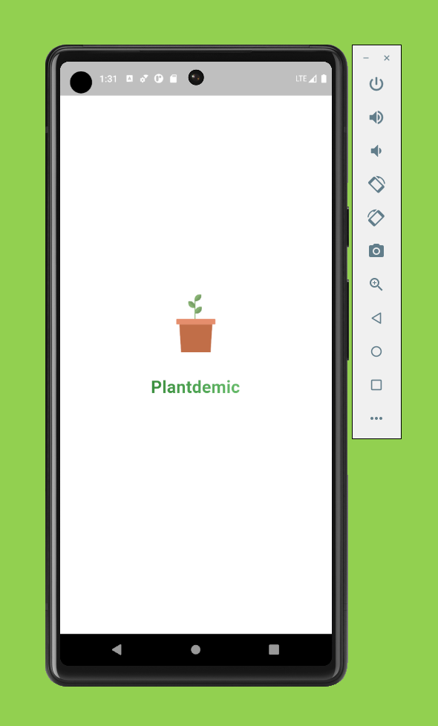




P
R
O
B
L
E
M
Notes:
Upon recognizing this, I made the decision to develop an application that would address these challenges.

Slide 9
S
O
L
U
T
I
O
N

Slide 10



S
O
L
U
T
I
O
N
Plantdemic
A Flutter-based Mobile Application for Plant Business Owners

Slide 11
S
O
L
U
T
I
O
N

Slide 12
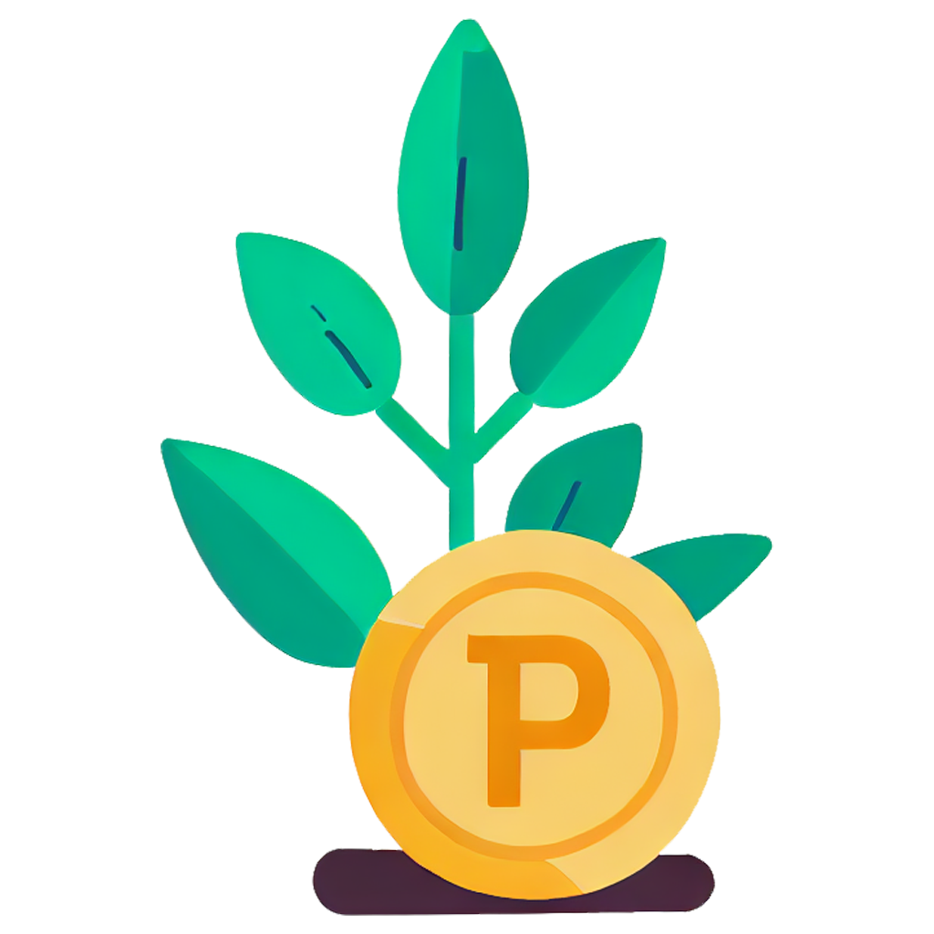

Slide 13



FEATURES
i
Plantdem c
Notes:
What is plantdemic?

Slide 14

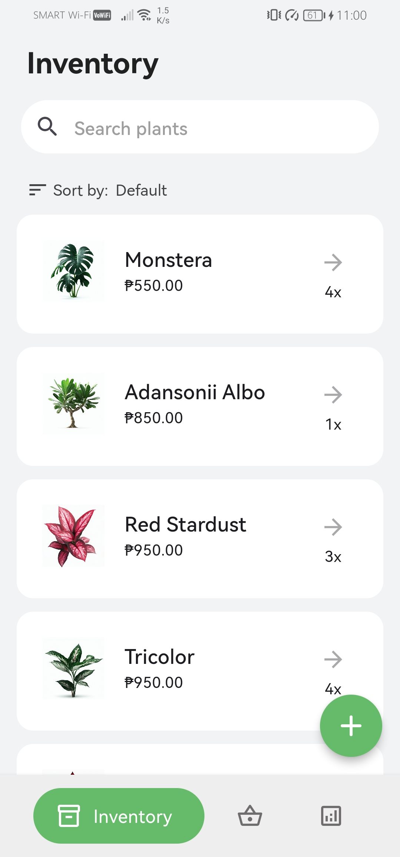
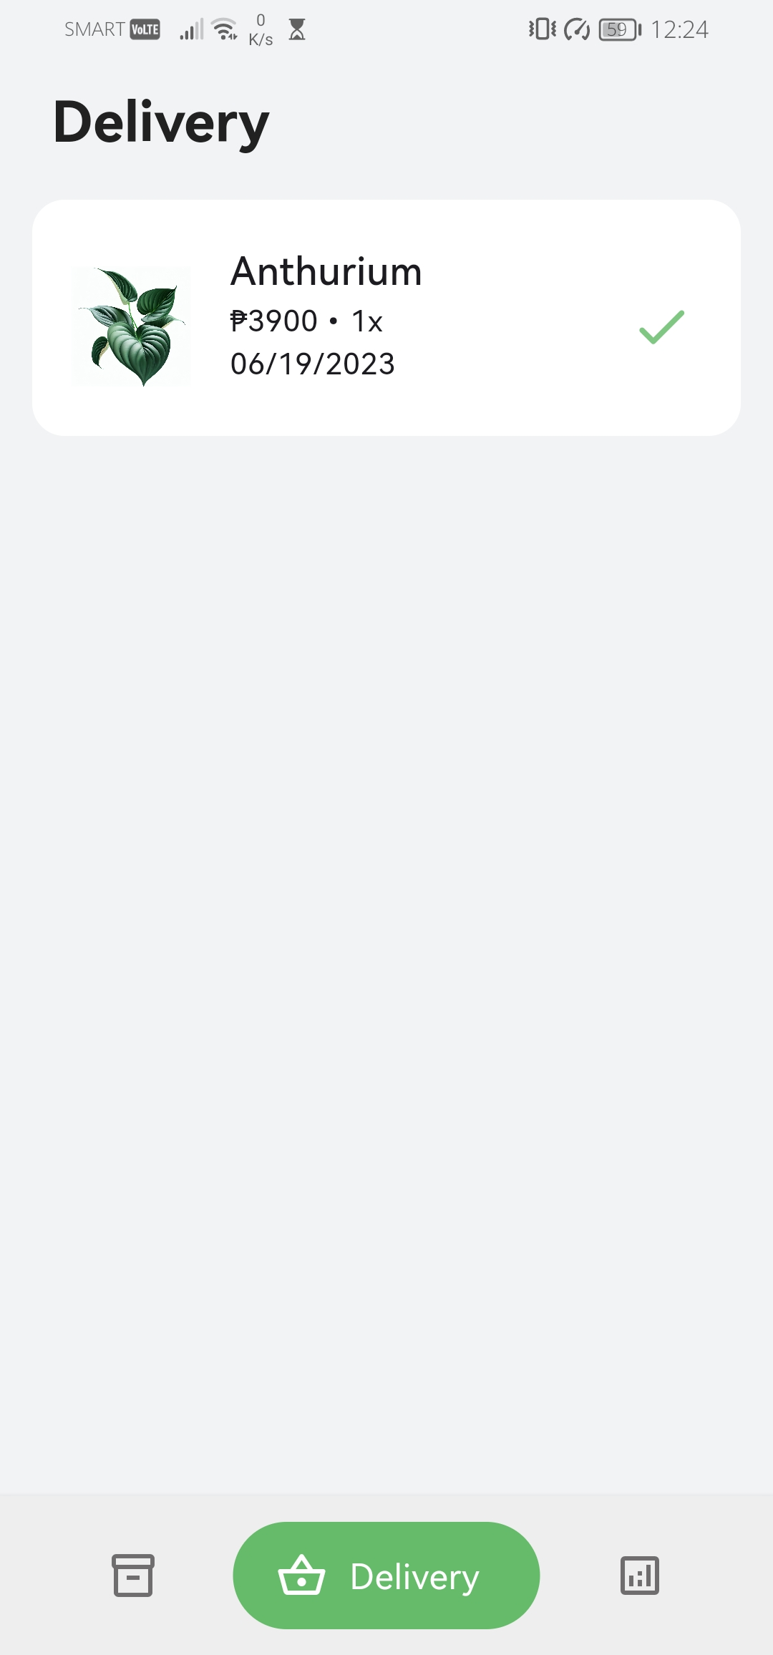
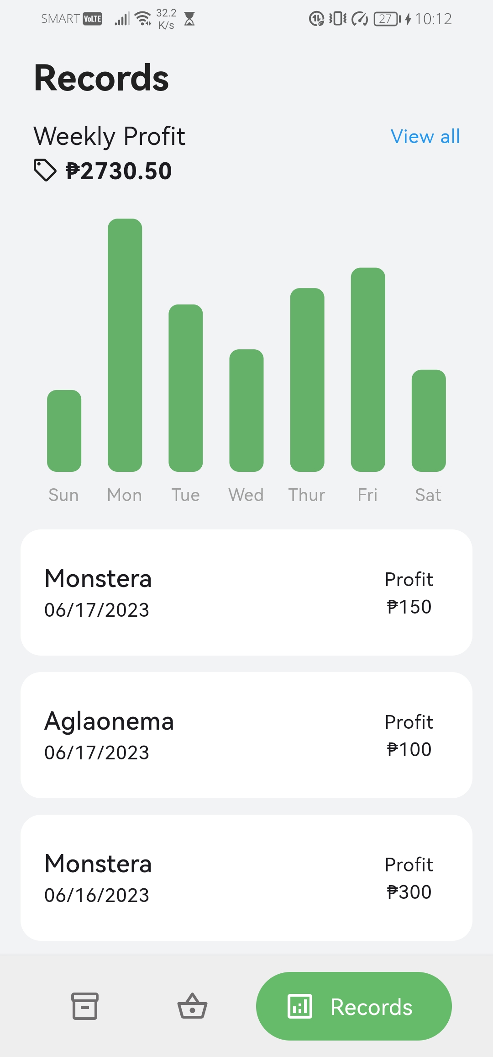
FEATURES
i
Plantdem c
Inventory
Delivery
Reports

Slide 15

features
plantdemic inventory
add and remove plant
edit plant information
search and sort
Inventory
Delivery
Reports

Slide 16

features
inventory
delivery
reports
plantdemic inventory
add and remove plant
edit plant information
search and sort

Slide 17
features
inventory
delivery
reports
plantdemic delivery
view delivery information
confirm plant delivery
remove plant from delivery

Slide 18
features
inventory
delivery
reports
plantdemic reports
view weekly profit
remove profit

Slide 19
scope and limitation
exclusive for mobile devices
deployment of the application was limited in scale
personally intended for the developer's mother
Notes:
The primary limitation of this project is its narrow focus on the development of the application's features exclusively for mobile devices. The application's requirements are tailored specifically to address the user’s wants and needs; thus, its relevance may not extend to other users. While the developer has plans for future scalability, the initial testing and evaluation of the application will be limited in scale. This is because the app is being exclusively developed for the developer's mother. Nevertheless, the application is intended to offer plant business owners an all-inclusive, simple, and user-friendly solution to streamline their business operations for optimal efficiency and convenience.

Slide 20
future potential
focus on scaling the application's capabilities to accommodate growing demands
incorporating additional features based on user feedback and industry trends
exploring opportunities for integration with other relevant systems or platforms
Notes:
To ensure the application keeps pace with the evolving needs of plant business owners, future improvements and enhancements can be explored. These endeavors would focus on scaling the application's capabilities to accommodate growing demands. Furthermore, incorporating additional features based on user feedback and industry trends could be considered, alongside optimizing the app's performance to handle larger datasets. Additionally, exploring opportunities for integration with other relevant systems or platforms would further streamline operations for plant business owners.
Overall, the development and testing of the "Plantdemic" app have successfully demonstrated its value in assisting plant business owners in managing their businesses effectively. With its user-friendly interface, comprehensive functionality, and potential for future enhancements, the "Plantdemic" app holds great promise for the plant industry, contributing to the growth and success of plant businesses in the digital era.

Slide 21
APP DEMONSTRATION

